Slide 1

PSU D.A.T.A Lab 2
By
Sarah Hegazy
Omar Al Hussaini
Erik Benscoter
Daniel Lambardo

Slide 2
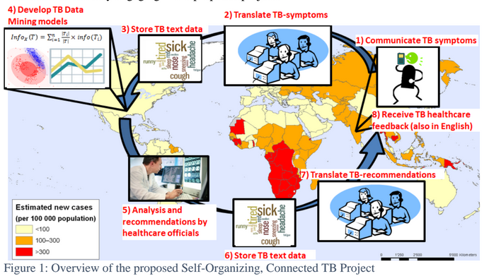
Cycle of text

Slide 3
Building and testing model
Selecting a model
Logistic regression model
Training and testing with data
with k fold cross validation
Using Receiver Operating Characteristic (ROC)

Slide 4
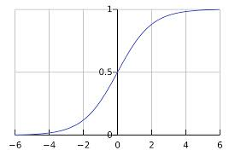
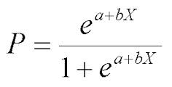
Logistic Regression Model
Takes any value between -∞ and +∞ and
Returns Results between 0 and1
the input is a linear equation with coefficients
For text, location and time
Advantages: low variance and so is less
prone to over-fitting and usely used to predict
diseases

Slide 5

Logistic Regression Model
Computing frequencies of words
Deciding which words to include in the equation based on the
association rule
“If a person says cough it’s 70% likely that he’s sick”
Word | “YES” freq. | “NO” freq. | Confidence
Sick | 500 | 50 | $$=\frac{\left(Sick∩\text{Yes}\right).count}{\left(Sick\right).count}$$
. . .
$$W_{n}$$
Coefficients

Slide 6
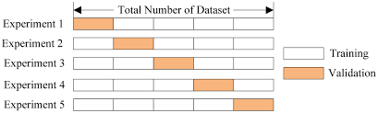

k Fold Cross Validation
Selecting a K value for experiments
For the 5000 tweets and k=5,
4000 tweets for training
1000 for testing
Calculate Accuracy
$$ACC= \frac{\sum{True positive+\sum{True negative}}}{\sum{Total population}}$$

Slide 7
Running new strings of text
Cleaning up the data
Remove stop words
Running model
Output prediction and push it back to user
Saving Result
Saving the string with the result for future analysis and recommendations (step 5 in cycle)
Decompose strings into words
Stemming verbs
Display on map

